Slide 1

Insights into Road Accident Dynamics
DSCC440 : Data Mining
Under the supervision of
Professor J. Luo
University of Rochester
A Machine Learning Approach to Accident Severity Prediction and Future Preparedness
Notes:
A staggering 42,939 fatalities were recorded all over the United States in the year 2022 that resulted from motor vehicle traffic crashes. As this figure continues to rise annually, it's imperative for us to take ownership of this issue, analyse it comprehensively, and devise preventive measures and solutions. To address this at a local level, we aim to utilize data mining and machine learning techniques to analyse crash report data collected from Montgomery County in Maryland.

Slide 2
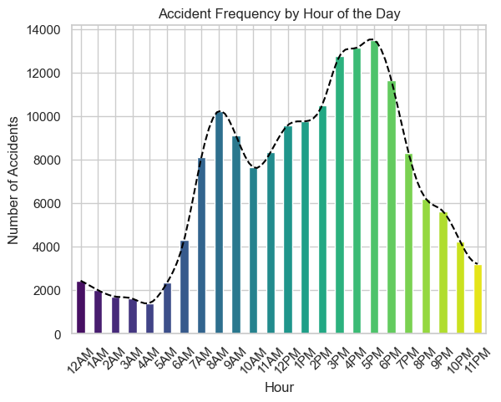
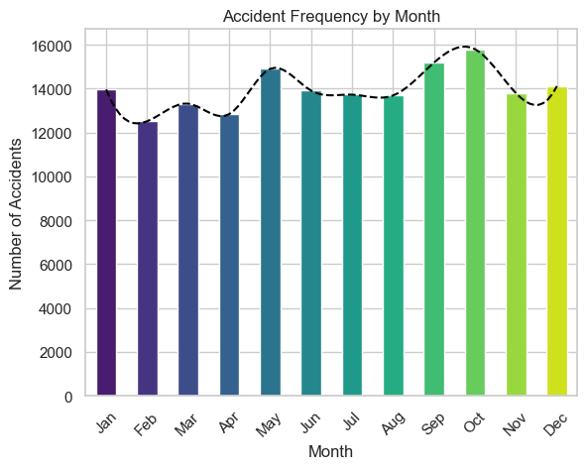
Exploratory Data Analysis
Notes:
The attribute for “Crash Data/Time” has the information available for hour of the day when a given crash occurred. Using that information a bar chart for the frequency of accidents by hour of the day has been plotted the left hand side. It is observed that the frequency of occurrence of accidents was highest between 3 p.m. and 6 p.m. and the least between 12 a.m. and 4 a.m.
The bar plot on the right shows the frequency of accident occurrences over different months of the year. It is explicit from the plot that there is no significant difference in the number of accidents across different months. However, the numbers peak around the months of September-October and the least frequency is observed in the months of February and April.

Slide 3
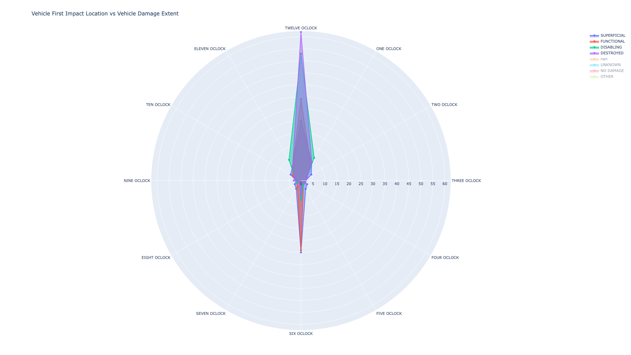
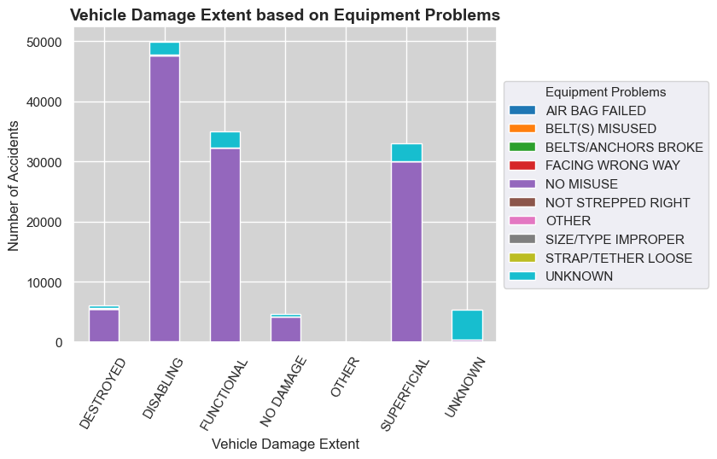
Exploratory Data Analysis
Vehicle First Impact Location vs Vehicle Damage Extent
Notes:
The plot on the left can be used to infer the relation of first impact location with the extent of vehicle damage. It can be clearly seen that the damages that destroy or disable the vehicles are pre-dominantly caused when the vehicle gets hit from the front. Whereas when the vehicle is hit from behind, the damage is at the most superficial, leaving the vehicle in functional condition.
The plot on the right shows the frequencies for each category of “Vehicle Damage Extent” with a stacked bar plot (by Equipment problems). From the bar plot it can be observed that most of the accidents involved no misuse of equipments. Among the “Vehicle Damage Extent” categories, “Disabling” is observed to have the maximum frequency followed by “Functional” and “Superficial”. “Destroyed” and “No damage” are observed to have much lower frequencies comparatively.

Slide 4
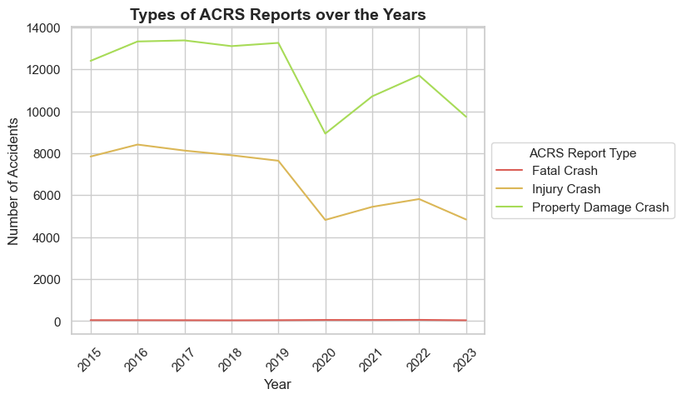
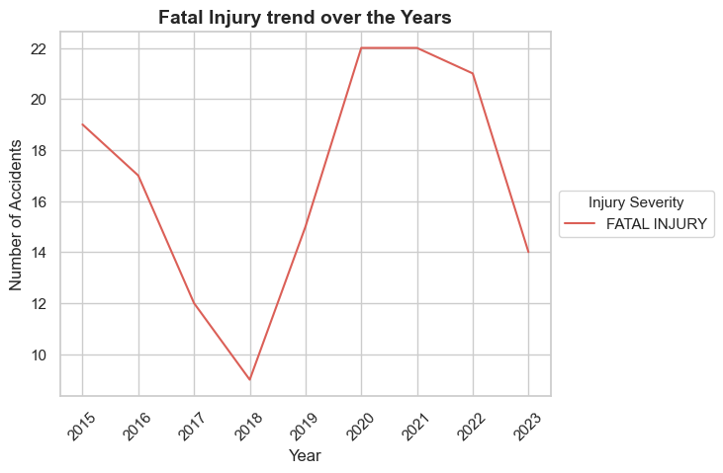
Exploratory Data Analysis
Notes:
The dataset has an attribute called “ACRS Report Type” that gives the classification of the type of crash as reported by the “Automated Crash Reporting System” as “Injury Crash”, “Property Damage Crash” and “Fatal Crash”. Plot on the left side shows a grouped line chart that compares the frequency trends of the three classes over the years. It is evident from the graphs that the order of maximum to minimum number of crash types is “Property Damage Crash” “Injury Crash” and “Fatal Crash” respectively. Also the “Property Damage Crash” and “Injury Crash” types show a steep dip in respective frequencies in the year 2020 which is suspected to be due to Covid-19 pandemic and peak again in 2022. Due to the comparatively low frequency of “Fatal Crash” types, it has been plotted in a separate figure on the right hand side.
It is also evident that the number of “Fatal Crash” report types spanned from 5 to 22 which is significantly lower than other ACRS report types.

Slide 5
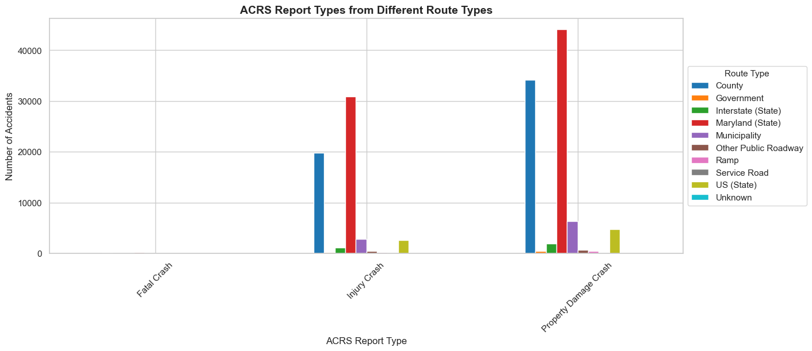
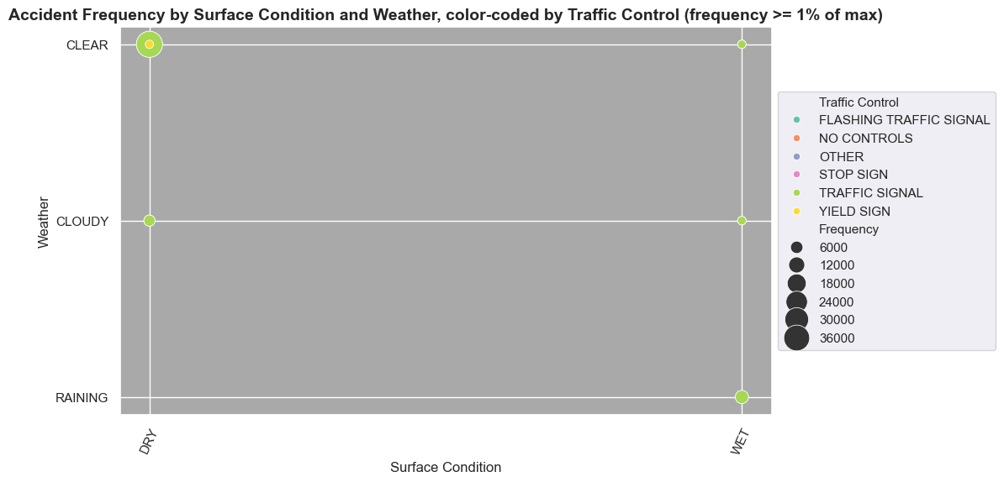
Exploratory Data Analysis
Notes:
To find the distribution of accident frequencies by route type (grouped by ACRS Report type), a bar chart has been plotted in figure present on LHS. It is observed that Maryland (State) type route had the most number of accidents followed by Counties for “Injury Crash” and “Property Damage Crash” types. Overall, the “Property Damage Crash” ACRS report type shows the maximum frequencies followed by “Injury Crash” and due to the highly skewed distribution, “Fatal Crash” type frequencies are not visible.
The plot present on RHS shows that the maximum frequency of accidents that occurred during “Clear” and “Dry” conditions and the least occurred during “Cloudy” and “Wet” conditions. This clearly signifies that weather and surface conditions did not have a major impact on the number of accidents.

Slide 6
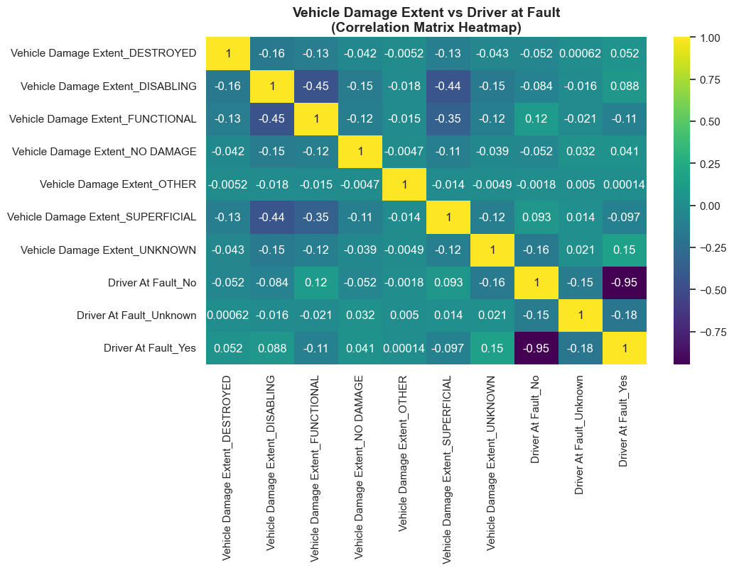
Exploratory Data Analysis
Notes:
The plot above is a heatmap depicting the correlation between different categories of vehicle damages and different states of driver at fault attribute. The area to focus on is highlighted white border.
The matrix shows that when the driver is not at fault, the vehicle damage extent shows maximum correspondence to the “Functional” category with a correlation of 0.12 (ignoring the “Unknown” category). And when the driver is at fault, the vehicle damage extent shows maximum positive correspondence to the “Disabling” category with a correlation of 0.088 (ignoring the “Unknown” category).

Slide 7
Methodology
Clustering &
Mining Cluster Specific Frequent Factors
Classification
Time Series
Analysis
Notes:
The ACRS(Automated Crash Reporting System) dataset has around 43 attributes and data points of 167,799 crashes, giving us a wide scope to analyze and implement different techniques.

Slide 8
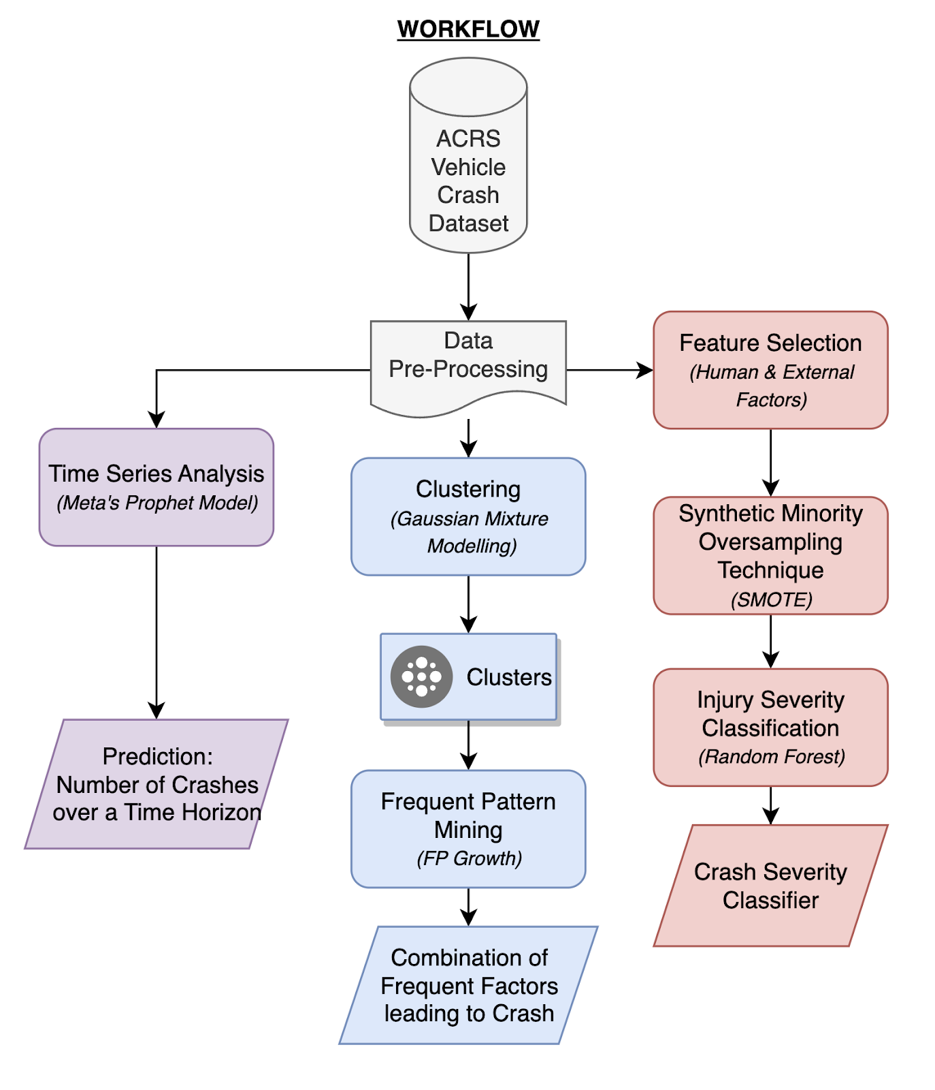
Notes:
1) With attributes like Latitude, Longitude, we got the opportunity to come up with insights taking into account the location of crashes. We therefore planned on performing clustering to segregate the total county into different zones.
2) Focusing on determining Injury Severity, we planned on implementing a classifier, which given a set of conditions like Weather, Road Surface Condition, etc., would predict the injury severity of a crash in that scenario.
3) The dataset provided vehicle crash data since 2015, we planned to analyze the frequency of accidents over the years and also come up with a forecast that would aid in planning preventive measures.

Slide 9
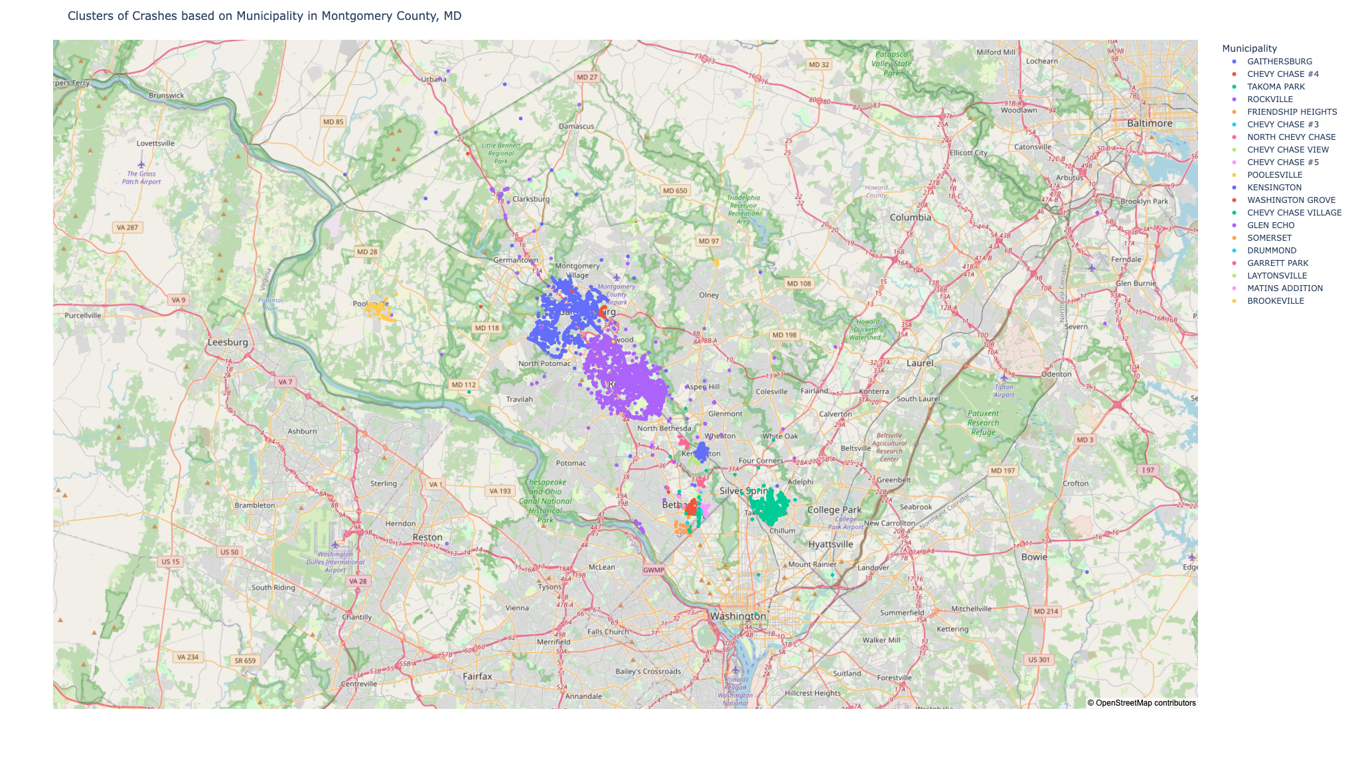
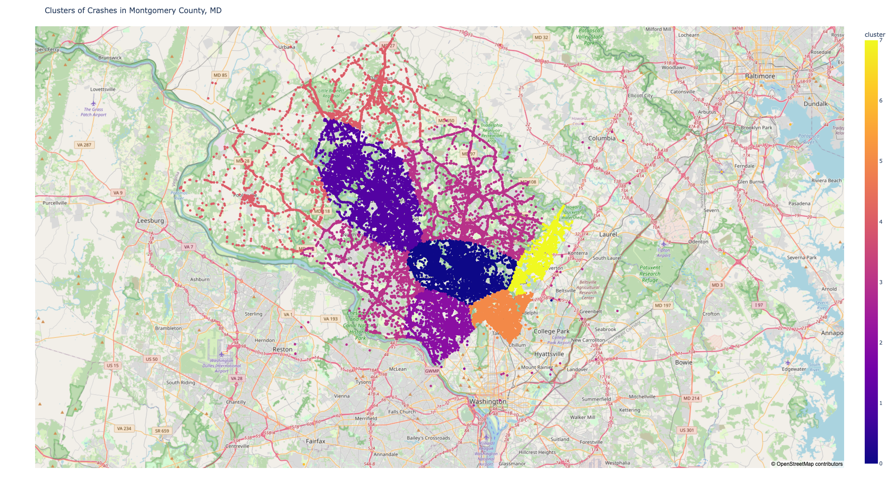
Clustering Crash Site Locations
Notes:
We used Gaussian Mixture Model to generate clusters based on Longitude and Latitude of crash site. We plotted the “Municipalities” associated with each crash site. The plot can be observed on the left hand side. We can clearly see two major dense clusters in the plot: Gaithersburg and Rockville: two urban centers situated along one of the highways. Other crash sites are sparse. That was due to the fact that majority of the values of “Municipality” attribute were null and therefore didn’t provide a complete information of locality. Therefore, we primarily relied on the two centers to finalize the clusters. The final cluster location is provided on right hand side plot.

Slide 10
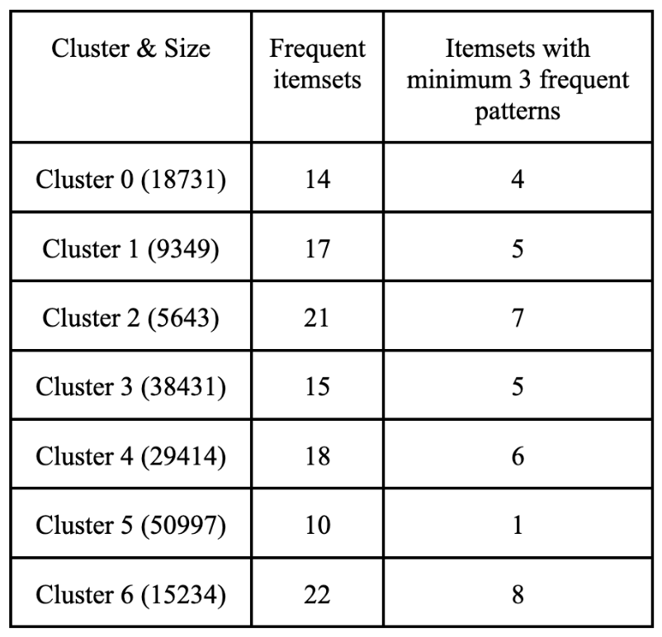
FREQUENT PATTERN MINING
Constraints for pattern mining using FPGrowth
'ASSOCIATION_NUM_ATTRIBUTES': 4,
'SUPPORT_NUM_ATTRIBUTES': 5,
'ASSOCIATION_RULE_THRESHOLD': 0.8,
'MIN_LENGTH_OF_PATTERN': 3,
'SUPPORT_THRESHOLD_PERCENTAGE': 40,
'MAX_NUM_OF_FREQUENT_PATTERNS': 30
Cluster-wise Frequent Patterns
Notes:
The next step after dividing the accident data into zones of occurence, is to find the most commonly occurring combinations of factors that have influenced or accompanied the accident occurences in each respective zone and also compare the commonalities and differences in these factors between different zones. The FP Growth pattern mining algorithm was applied to the data for each cluster (zone) individually to be able to mine frequent patterns (of factors) for every zone. The minimum support was kept at 40% and the association rule threshold was kept at 80%. Due to the vastness of the data additional constraints were applied for the analysis of similarities of patterns in different zones. The maximum number of frequent patterns for each cluster was capped at 30 and the minimum length of pattern was kept as 3. The given table summarises the numbers of frequent patterns obtained for each cluster.
On obtaining the results, it is found that the frequent itemset set ('County', 'Montgomery County Police', 'NO APPARENT INJURY') is common in all the clusters. The frequent itemset sets ('Montgomery County Police', 'NO APPARENT INJURY', 'Property Damage Crash') and ('County', 'NO APPARENT INJURY', 'Property Damage Crash') are common in 6 out of 7 clusters. On examining the rest of the frequent itemsets, it is observed that each of the zone has peculiar results in terms of “Agency Name”, “Injury Severity” and “ACRS report type” among others. It is natural that for different zones, the agencies involved will vary but through this process of pattern mining, the zones can further be identified as hotspots for severe or less severe accidents among other applications.

Slide 11
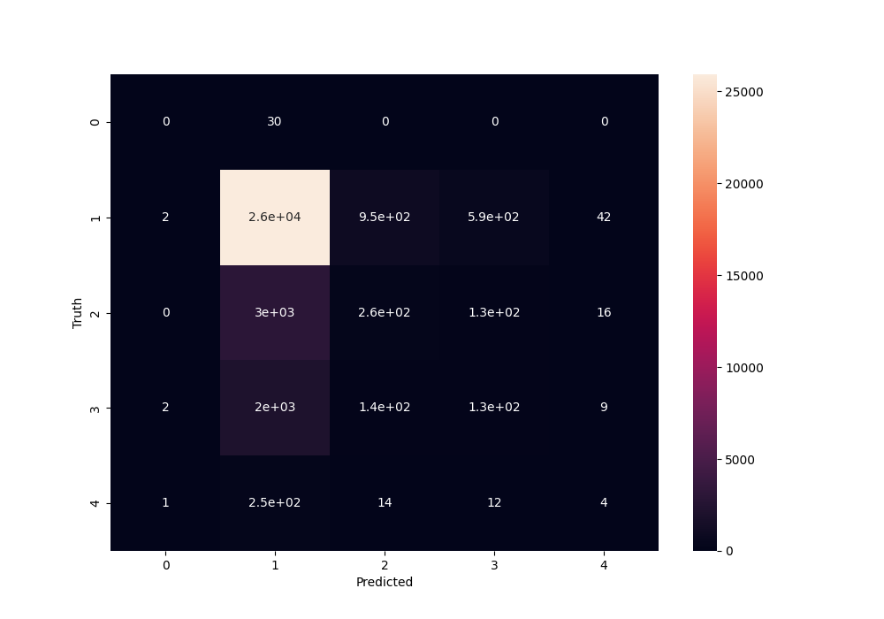
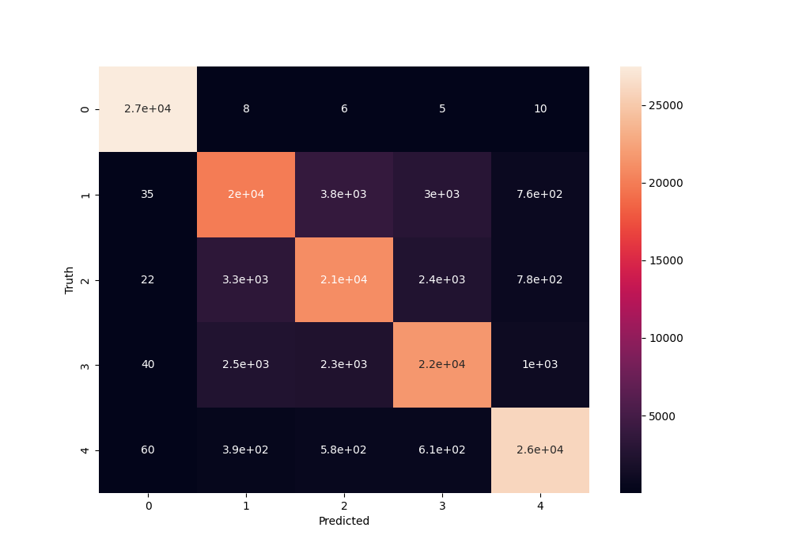
CLASSIFICATION
TACKLING CLASS IMBALANCE WITH SMOTE
Confusion matrix for original data
Confusion matrix after over-sampling with SMOTE
Notes:
This study also aims to render a model that can classify an occurrence of accident in terms of “Injury Severity” based on values of other attributes (this is a completely separate study from the clustering analysis and pattern mining). However, as mentioned in the data preprocessing section, the target class was imbalanced. Therefore, the SMOTE (Synthetic Minority Oversampling Technique) was used for resampling of the minority classes. A number of classifiers are available for training and were tried and tested on the given data of which Random Forest gave significantly better results. This paper only discusses the training and results of the Random Forest classifier. Results: An accuracy of 84.27 % was achieved. Further insights into the performance analysis could be derived from the confusion matrix which has been included in the report.

Slide 12
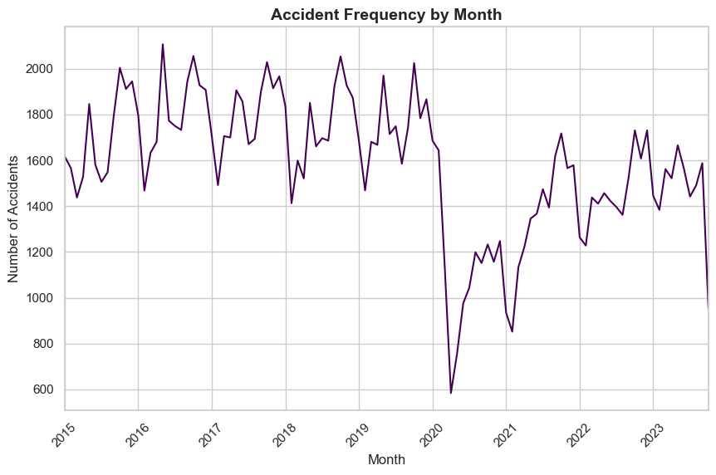
TIME SERIES ANALYSIS
Notes:
The analysis aimed to delve into the temporal patterns of crashes based on the 'Crash Date/Time' column from the ACRS dataset. Utilizing Facebook's Prophet package, an in-depth exploration of crash frequency and prediction over time was conducted. In our modeling approach we utilized a Prophet model to discern temporal trends and predict crash occurrences for the upcoming 365 days. As shown in the figure here, discernible recurrent patterns or fluctuations were observed, manifesting at consistent year-long intervals. This characteristic is termed as "seasonality" within the time series analysis domain. Our model, configured with enabled yearly_seasonality, was tailored to our prepared dataset, enabling precise predictions for the future timeframe.

Slide 13
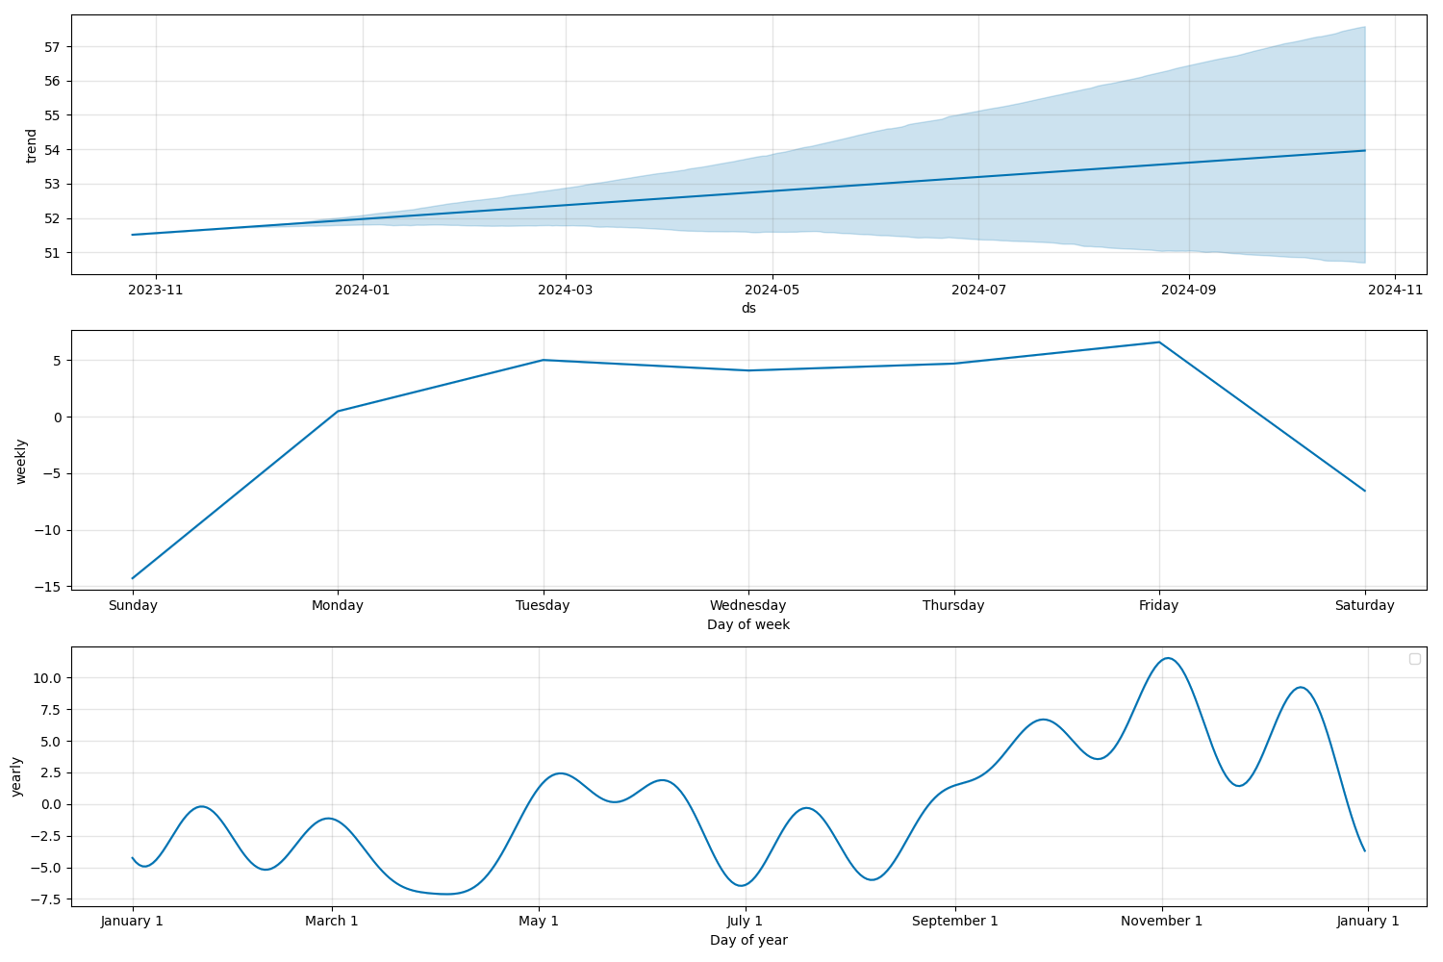
Time series analysis
Model Components
The weightage the model would provide
to predict the crash frequency based on
the date, day and year of timestamp.
Eg: Accidents are more likely from
Tuesday to Friday and in November
Notes:
Understanding the weekly, monthly and yearly trend patterns is essential for informed decision-making in areas such as traffic management, law enforcement, and the implementation of safety measures. By giving substantial weightage to the temporal aspects of the timestamp, the model equips stakeholders with valuable insights into when accidents are more likely to happen, allowing for proactive measures to enhance road safety during specific time periods.

Slide 14
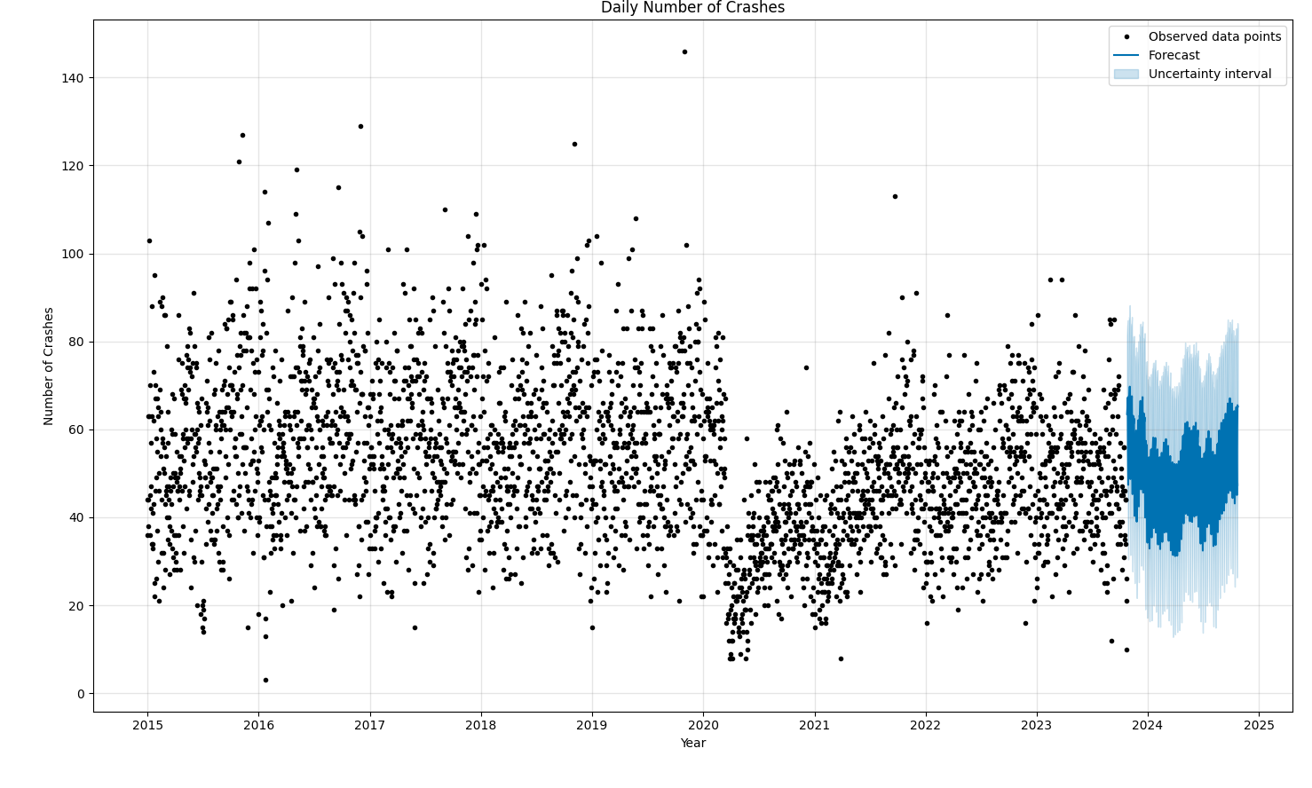
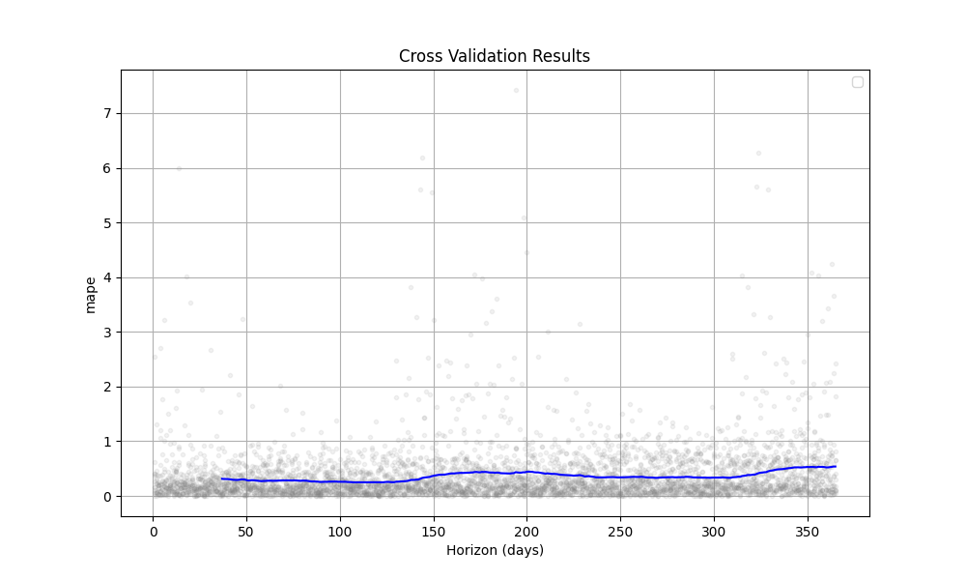
TIME SERIES ANALYSIS
Mean Average Percent Error vs Time(days)
Forecast for the year 2024
Notes:
The dataset was split in 4:1 ratio into training and testing to evaluate the model's performance on unseen data. The model was trained on the training set, and its predictions were compared to the actual crash occurrences from the testing set. Cross-validation was performed to assess the model's performance. The results were computed and visualized (figure on the left) using metrics like Mean Absolute Percentage Error (MAPE), aiding in evaluating the model's accuracy and robustness.
In the figure on the right, the black dots represent observed data points, while the dark blue area indicates the forecast for future years. Additionally, the forecast encompasses an extended area depicted in light blue, providing a forecast interval accounting for uncertainty surrounding the predicted number of car crashes. The plot reveals a significant drop in the number of car crashes in 2020. This decline can primarily be attributed to reduced vehicle travel due to Covid-19 pandemic lockdowns implemented across the country. Subsequently, there is an upward trend from 2020 to 2021, followed by a relatively stable frequency in the ensuing years. It demonstrates a positive outcome: the overall frequency of vehicle crashes has been lower compared to pre-pandemic years.
This comprehensive analysis using Prophet facilitated the understanding of temporal crash patterns, forecasted future trends, and evaluated the model's performance, providing valuable insights into crash occurrences based on the provided dataset.

Slide 15

DSCC 440 Final Project [FALL 2023]
By
- Neel Agarwal
- Jayant Patil
Notes:
Future Scope: the study's future scope involves incorporating dynamic and updated data into trained models, particularly the time series model. This approach ensures continuous monitoring of evolving patterns in accident occurrences, enabling timely adjustments to preventive measures. Additionally, the dataset's numerous attributes offer an avenue for exploring patterns in vehicle characteristics associated with varying levels of damage and impact. Employing a similar classifier to the one utilized in this study holds promise for unveiling valuable insights. In conclusion, this research not only contributes to our understanding of current accident patterns but also lays the foundation for a dynamic and adaptive system capable of addressing evolving challenges in road safety.

Slide 16

Thank You
Notes:
We express our sincere gratitude to Professor J. Luo, our subject instructor, for providing exemplary guidance and supervision during the entirety of this project. We are also thankful to our teaching assistants, A. Mathur and J. Long, for their invaluable support.

